Slide 1
Chapter 3: Nomenclature, Physical Properties and Structure
Assigned Reading: 3.1-3.8

Slide 2
Chapter Objectives
Know the names of the first 10 straight chain hydrocarbons.
Be able to name branched chain hydrocarbons; hydrocarbons with other substituents; other functional groups covered in this chapter.
Recognize primary, secondary and tertiary carbons & hydrogens.
Name alkenes and substituted alkenes according to IUPAC rules.
Be able to name molecules containing various functional groups such as amines, alcohols, esters, aldehydes, ketones, etc
Recognize priorities of functional groups in naming for molecules containing multiple functional groups
Understand the different types of intermolecular interactions and their impact on physical and chemical properties.
Be able to explain the boiling point and melting point trends and solubility based on intermolecular interactions.
Be able to draw the different conformation of chain molecules
Be able to draw different conformations of substituted and non-substituted cyclohexanes

Slide 3
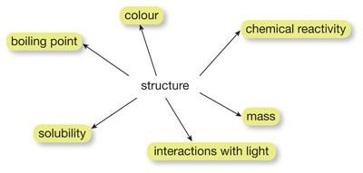
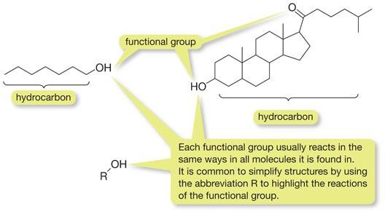
Chemical Structures
Chemical reactions primarily happen at the functional group of a molecule.

Slide 4
Functional Groups
There is a direct relationship between structure and reactivity.
A group of atoms within molecule that define the chemical properties is called a Functional Group .
We can focus on the reactivity of these groups, instead of learning the reactivity of many individual molecules.

Slide 5
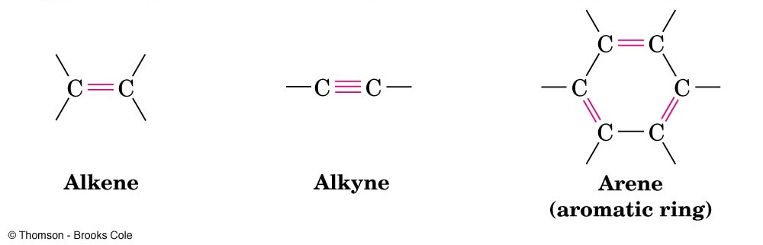
X = halogen
Alkyl Halide Alcohol Amine Ether
Aldehyde Ketone Caboxylic Acid Ester Amide

Slide 6
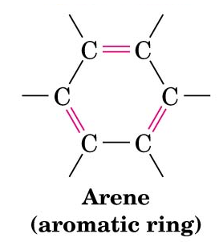
Hydrocarbons – organic compounds containing only C and H
Aliphatic and aromatic
saturated hydrocarbons
only C-C and C-H single bonds (maximum number of H)
alkanes
cycloalkanes (contain rings)
unsaturated hydrocarbons
- contain C-C double or triple bonds
alkenes alkynes

Slide 7
Alkanes: Structure
Alkane (or aliphatic hydrocarbon): a saturated hydrocarbon whose carbons are arranged in a chain
General formula: C_{n}H_{2n+2} n = 1,2….
tetrahedral about carbon; all bond angles are approx. 109.5°
All C’s in alkanes are sp³ hybridized.

Slide 8
Naming
Earlier times:
Organic compounds named by their discoverer usually after
source or use or smell/taste, etc.
CH₄N₂O C₁₇H₁₉NO₃
Urea Morphine, painkiller
(comes from urine) Morpheus Greek God of Dreams
putrescine
cadaverine
vanillin cinnamaldehyde
(vanilla odor) (cinnamon flavor)
As the number of known compounds grew, this became very impractical!

Slide 9
Nomenclature: IUPAC system: formal system for assigning distinct name to each compound
Parent and suffix “ane” specifies an alkane.
Alkanes form a homologous series: differ by one CH₂ group for each member of series
Prefix &
Carbons
1
methane
2
ethane
3
propane
4
butane
5
pentane
6
hexane
7
heptane
8
octane
9
nonane
10
decane

Slide 10
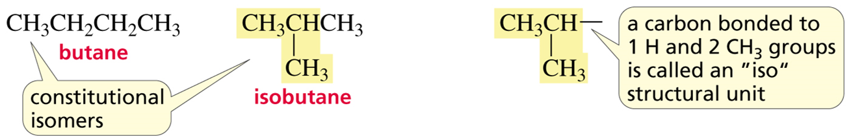
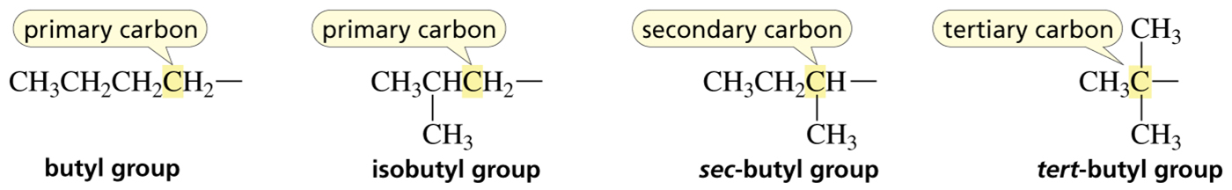
- H
Alkane becomes Alkyl grp Abbrev
CH₄ -CH₃ methyl Me
CH₃CH₃ -CH₂CH₃ ethyl Et
CH₃CH₂CH₃ -CH₂CH₂CH₃ n-propyl n-Pr
CH₃CHCH₃ isopropyl i-Pr
CH₃CH₂CH₂CH₃ -CH₂CH₂CH₂CH₃ n-butyl n-Bu
CH₃CH₂CHCH₃ sec-butyl s-Bu
CH₃CHCH₃ CH₃CHCH₂- isobutyl i-Bu
C(CH₃)₃ tert-butyl t-Bu
CH₃
CH₃

Slide 11
Classification of C & H
Primary (1°) C: a carbon bonded to one other carbon
1° H: a hydrogen bonded to a 1° carbon
Secondary (2°): a carbon bonded to two other carbons
2° H: a hydrogen bonded to a 2° carbon
Tertiary (3°) C: a carbon bonded to three other carbons
3° H: a hydrogen bonded to a 3° carbon
Quaternary (4°) C: a carbon bonded to four other carbons
1º carbon
4° H: no such thing…… WHY?
3º carbon
primary hydrogen
CH₃
C
CH₃
CH₃
tertiary hydrogen
4º
carbon

Slide 12
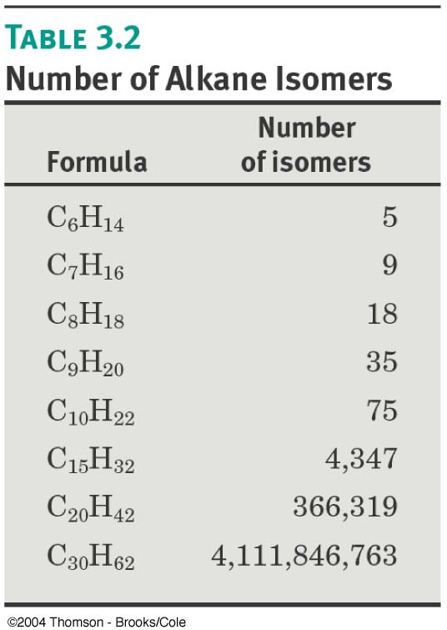
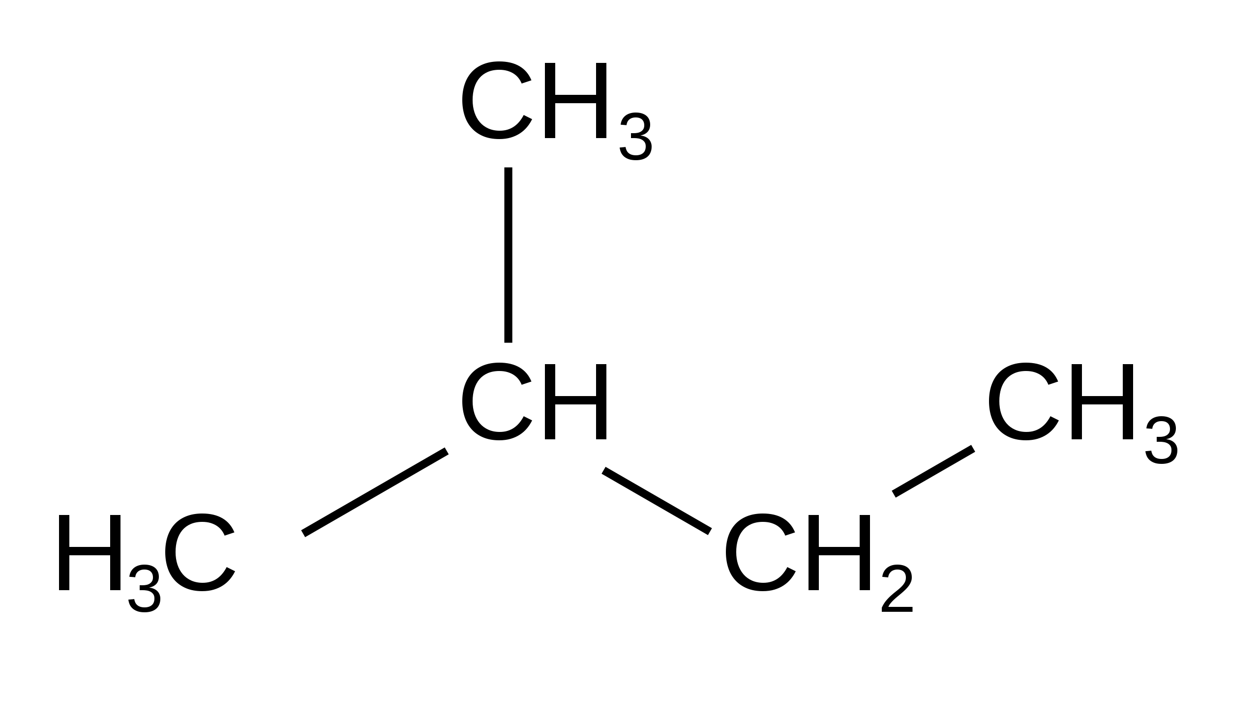
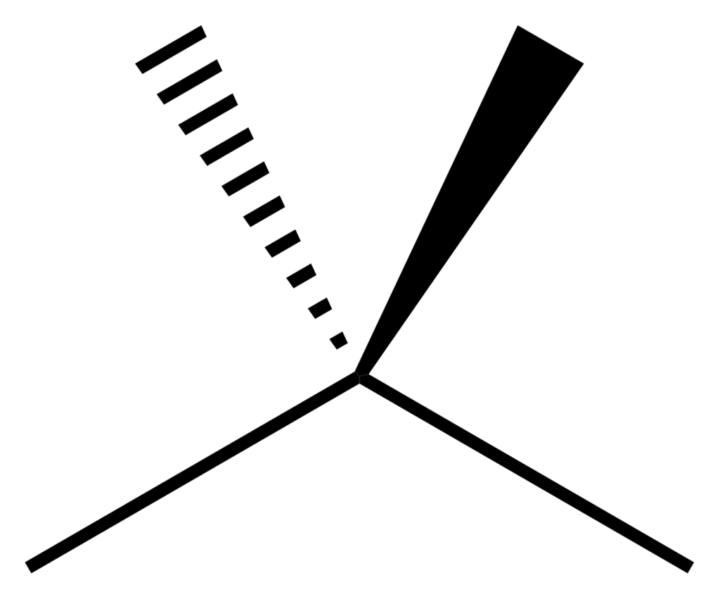
Constitutional or Structural isomers: compounds with the same molecular formula but a different connectivity (different order of attachment of their atoms)
For n > 3, alkanes can have constitutional isomers (different bonds). As C # increases, number of isomers increases dramatically-NO FORMULA; write out systematically.
pentane
isopentane
neopentane

Slide 13
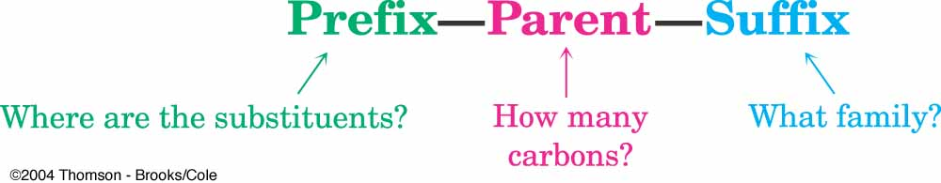


Nomenclature – systematic naming
What functional group?
Alkanes – suffix “ane”
Find parent
longest continuous carbon chain (may have to turn corners)
if 2 chains are the same, chose one with most branches.
2
5
6
1
heptane
7
3
4

Slide 14

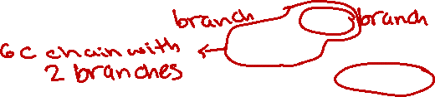

Nomenclature – systematic naming
What and
Alkanes – suffix “ane”
Find parent
longest continuous carbon chain (may have to turn corners)
if more than one chain with same length, chose one with most branches.
2
5
6
1
heptane
7
3
4

Slide 15
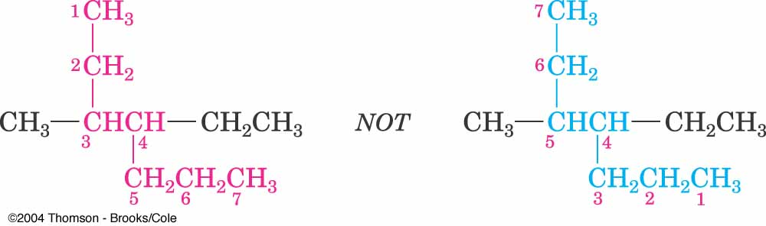
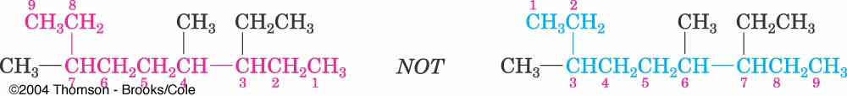
Find prefix:
Number atoms in parent chain.
a) start at end closest to the first branch (lowest possible numbers to branches)
b) if first branch at equal distance to both ends of chain, number at end closest to the second branch point (name must contain lowest of possible numbers)

Slide 16
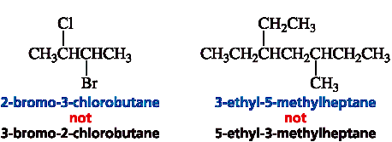


c) if same substituent numbers obtained in BOTH directions, number at end closer to substituent coming first alphabetically
2
5
3
3
2-bromo-3-chlorobutane
3-ethyl-5-methylheptane
3. Identify the substituents (name branches), give their position (#) on parent chain, place name of substituents in front of parent name
Substituents:
Alkyl groups : PARENT + yl Halogens
-CH₃ methyl -Cl chloro
-CH₂CH₃ ethyl -Br bromo
-I iodo

Slide 17


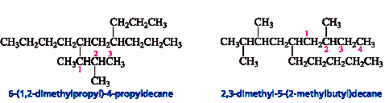
If substituent complex, use systematic substituent names in parentheses
Number alkyl subst. from carbon attached to parent hydrocarbon
Place name inside parentheses after number of parent hydrocarbon it is attached to.
Names such as “isopropyl”, “sec-butyl” and “tert-butyl” acceptable for subst. by IUPAC
Write the name as a single word.
a) use hyphens to separate numbers and words.
b) use commas to separate numbers.
c) place substituents in alphabetical order.
d) use di, tri, tetra for >2 identical substituents-each substituent must have #.
e) di, tri, tetra, sec, and tert ignored in alphabetizing.
f) iso and cyclo NOT ignored in alphabetizing.
6-(1,2-dimethylpropyl)-4-propyldecane 2,3-dimethyl-5-(2-methylbutyl)decane

Slide 18
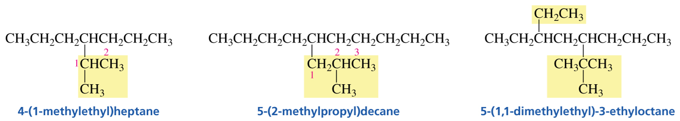
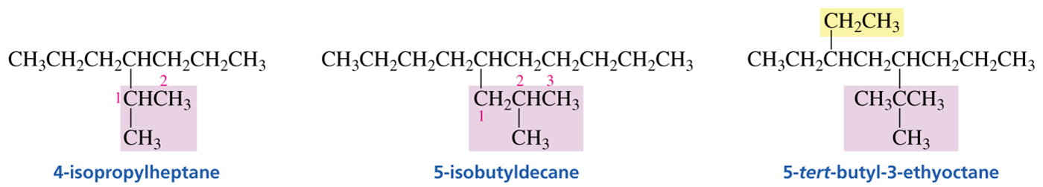
Branched Substituents
If the substituent has a common name, the common name can be used instead of the parenthetical name.
Notes:
4-(1-methylethyl)heptane has a structure of C H 3 C H 2 C H 2 C H C H 2 C H 2 C H 3. The fourth carbon (from left to right) has a single bond to C 1 (from left to right) of C H C H 3, which also has a single bond to C H 3.
5-(2-methylpropyl)decane has a structure of C H 3 C H 2 C H 2 C H 2 C H C H 2 C H 2 C H 2 C H 2 C H 3. The fifth carbon (from left to right) has a single bond to C 1 (from left to right) of C H 2 C H C H 3, where C 2 has a single bond to C H 3.
5-(1,1-dimethylethyl)-3-ethyloctane has a structure of C H 3 C H 2 C H C H 2 C H C H 2 C H 2 C H 3. The third (from left to right) carbon has a single bond to C H 2 C H 3. The fifth carbon has a single bond to C 1 of C C H 3, where C 1 also has single bonds to two more C H 3 groups.

Slide 19
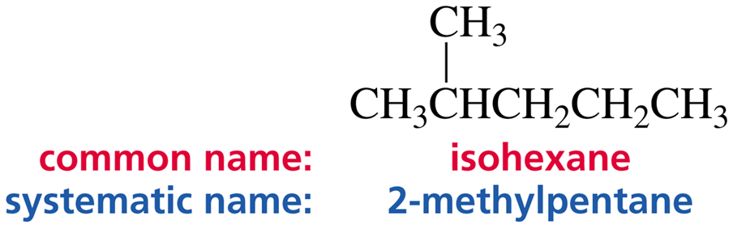
Common versus Systematic Nomenclature
Common names never have numbers.
Only systematic names have numbers.

Slide 20
Cycloalkanes
Cycloalkanes are saturated hydrocarbons with at least one
ring.
Ring sizes from 3 to 30 and more are known.
General formula: C_{n}H_{2n} n = 3, 4, 5…
Prefix: cyclo (added to alkane name with same number of C)
= (CH₂)_{n}
n = 3 n = 4 n = 5 n = 6
cyclopropane cyclobutane cyclopentane cyclohexane

Slide 21
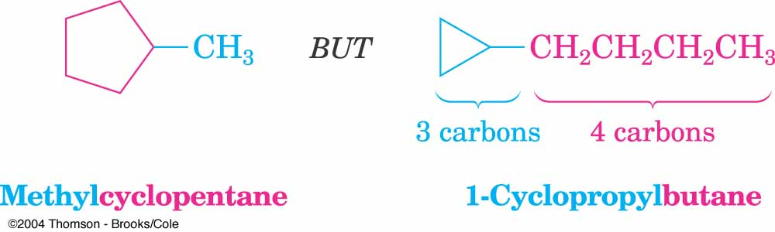

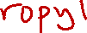
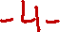
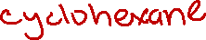
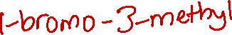
Naming Cycloalkanes
Find parent
a) if the ring contains equal number or more carbons than the longest chain, parent is cycloalkane.
b) if chain is longer, then parent is alkane and ring is a substituent.
Number the ring.
#1 is the first substituent in alphabetical order.
Number rest of ring to give lowest numbers for substituents.
if only one substituent, leave out numbers.
2
4
2
1
1

Slide 22
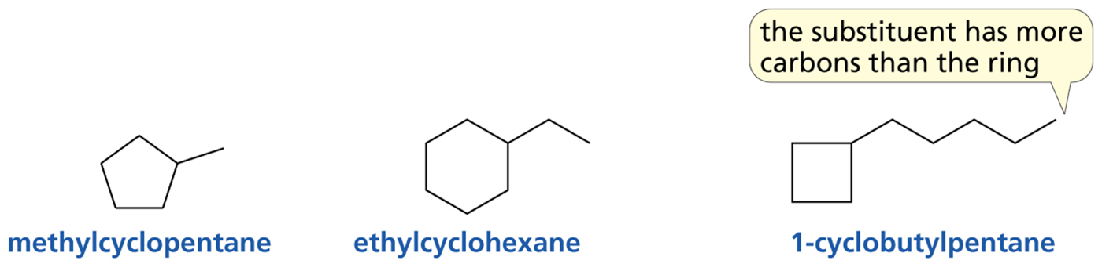
Monosubstituted Cycloalkanes Examples
A number is not needed.

Slide 23
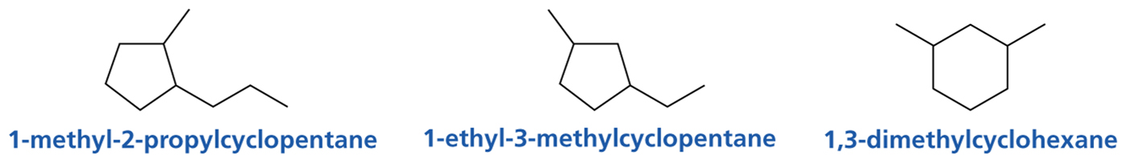
Disubstituted Cycloalkanes Examples
Substituents are stated in alphabetical order. #1 goes to the first-listed substituent.
Notes:
1-methyl-2-propylcyclopentane has a structure of a ring with five vertices, where C 1 has a single bond to a one-carbon substituent, and C 2 has a single bond to the first carbon of a three-carbon chain.
1-ethyl-3-methylcyclopentane has a structure of a ring with five vertices, where C 1 has a single bond to a two-carbon substituent, and C 3 has a single bond to a one-carbon substituent.
1,3-dimethylcyclohexane has a structure of a ring with six vertices, where C 1 has a single bond to a one-carbon substituent and C 3 has a single bond to another one-carbon substituent.

Slide 24
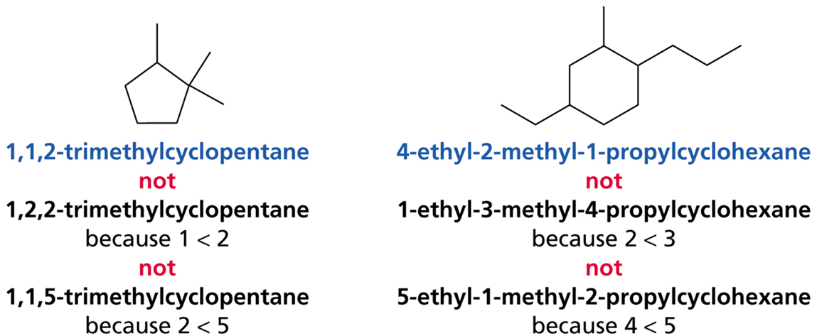
Multi-Substituted Cycloalkanes_Two Substituents with the Same Low Number
If more than one name has the same low number, choose the name with the next lowest number.
Notes:
1,1,2-trimethylcyclopentane has a structure of a ring with five vertices, where C 1 has single bonds to two C H 3 groups, and C 2 has a single bond to C H 3. 1,2,2-trimethylcyclopentane is a wrong name, because 1 is smaller than 2. 1,1,5-trimethylcyclopentane is a wrong name, because 2 is smaller than 5.
4-ethyl-2-methyl-1-propylcyclohexane has a structure of a ring with six vertices, where C 1 has a single bond to C H 2 C H 2 C H 3, C 2 has a single bond to C H 3, and C 4 has a single bond to C H 2 C H 3. 1-ethyl-3-methyl-4-propylcyclohexane is a wrong name, because 2 is smaller than 3. 5-ethyl-1-methyl-2-propylcyclohexane is a wrong name, because 4 is smaller than 5.

Slide 25
Naming Bicyclic Compounds
Bicycloalkanes: two fused or bridged rings
Bridgehead: carbon atoms common to
both rings
Two carbon bridge
=
Bicyclo[2.2.1]heptane
One carbon bridge: carbon atom connecting
bridgehead atoms
Find parent: prefix bicyclo with name of alkane with same number of carbon atoms
Put number of carbon atoms in each bridge in brackets after parent name- in order of decreasing length
If substituents present, number both bridged ring systems, starting at one bridgehead going along the longest bridge to other bridgehead, then along next longest back to first bridgehead. Shortest bridge numbered last.

Slide 26
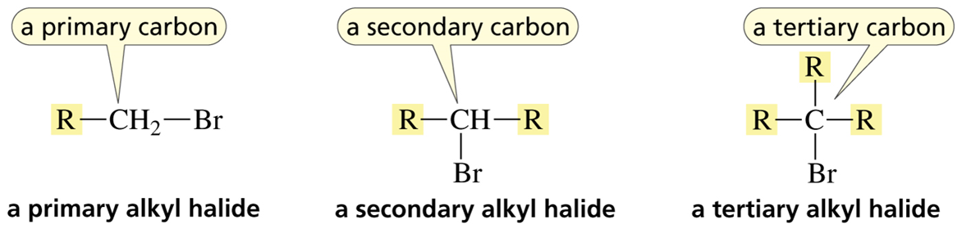
Classification of Alkyl Halides
primary alkyl halide: halogen is on a primary carbon
secondary alkyl halide: halogen is on a secondary carbon
tertiary alkyl halide: halogen is on a tertiary carbon
Notes:
A primary alkyl halide is R single bond C H 2 single bond B r. C is a primary carbon. A secondary alkyl halide is R single bond C H single bond R, where C is a secondary carbon that has a single bond to B r. A tertiary alkyl halide is R single bond C single bond R, where C is a tertiary carbon and has a single bond to R and a single bond to B r.

Slide 27
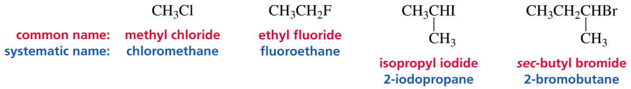
Common versus Systematic Nomenclature
Numbers are used only for systematic names.
Common names never have numbers.
Notes:
C H 3 C l has a common name of methyl chloride and a systematic name of chloromethane. C H 3 C H 2 F is ethyl fluoride or fluoroethane. C H 3 C H I, with a C H 3 group single-bonded to the second (from left to right) C, is isopropyl iodide, or 2-iodopropane. C H 3 C H 2 C H B r, with a C H 3 group single-bonded to the third (from left to right) C, is sec-butyl bromide, or 2-bromobutane.

Slide 28
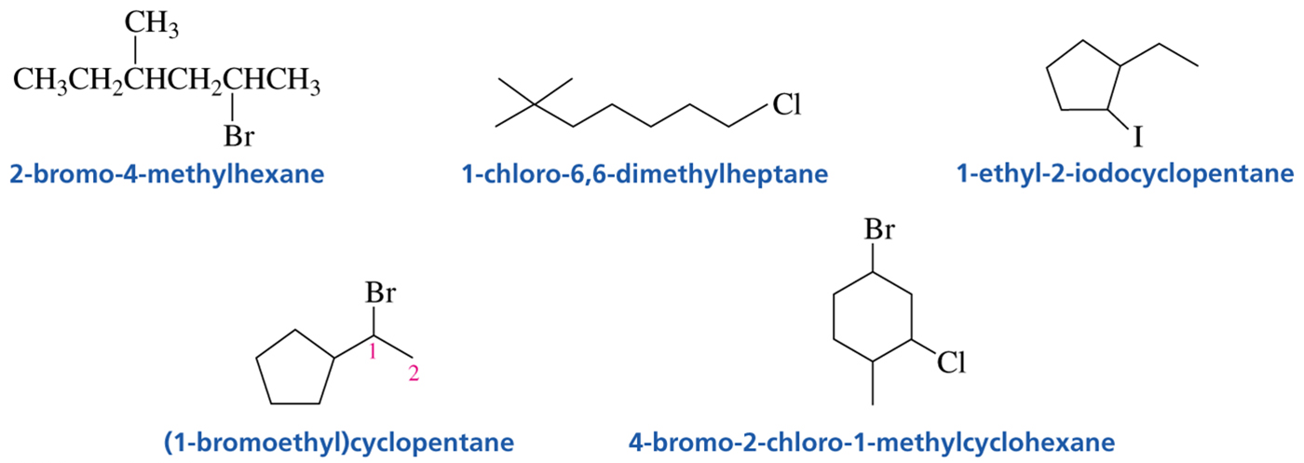
Nomenclature of Alkyl Halides
Notes:
2-bromo-4-methylhexane has a structure of C H 3 C H 2 C H C H 2 C H C H 3, where C 2 (from right to left) has a single bond to B r and C 4 has a single bond to C H 3.
1-chloro-6,6-dimethylheptane has a structure of a seven-carbon chain where C 1 has a single bond to C l and C 6 has single bonds to two one-carbon substituents.
1-ethyl-2-iodocyclopentane has a structure of a five-carbon ring. C 1 has a single bond to C H 2 C H 3, while C 2 has a single bond to I.
(1-bromoethyl)cyclopentane has a structure of a five-carbon ring that has a single bond to C 1 (from left to right) of C H C H 3, where C 1 also has a single bond to B r.
4-bromo-2-chloro-1-methylcyclohexane has a structure of a ring with six vertices, where C 1 has a single bond to C H 3, C 2 has a single bond to C l, and C 4 has a single bond to B r.

Slide 29
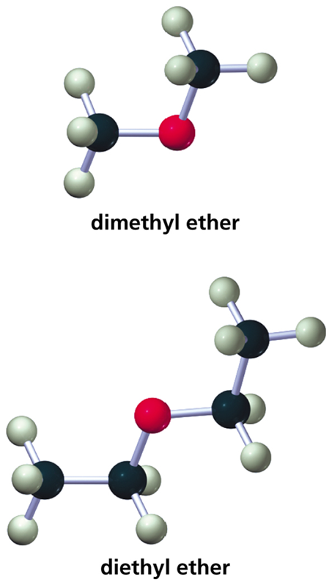
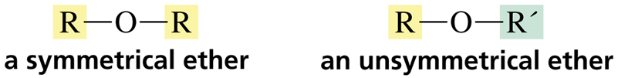
Ethers

Slide 30
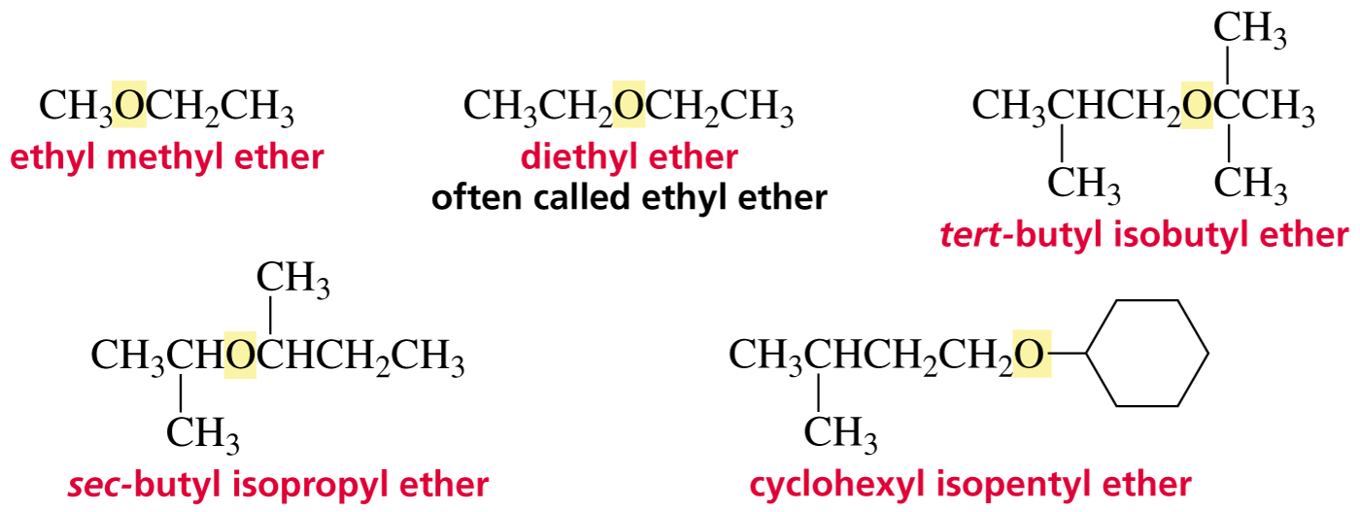
Common Names of Ethers
The substituents are listed in alphabetical order.

Slide 31
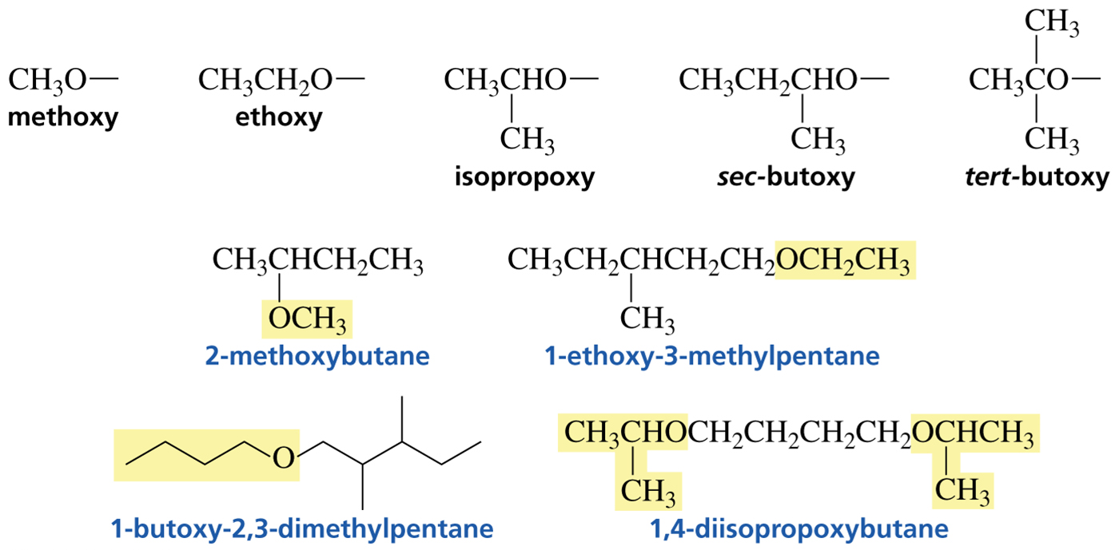
Systematic Names of Ethers

Slide 32
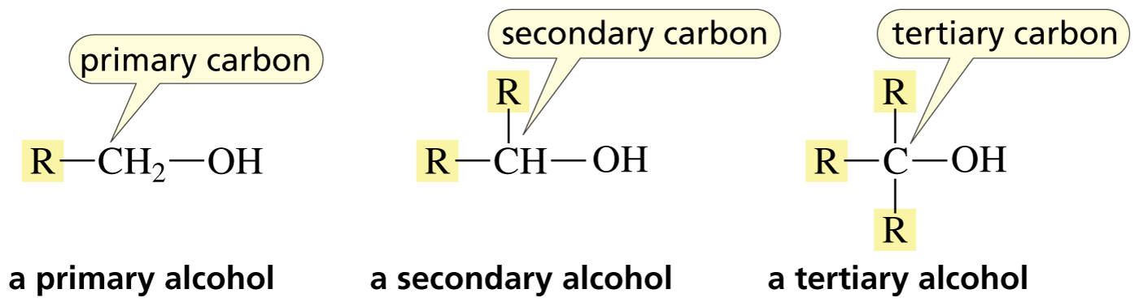
Classification of Alcohols
primary alcohol: O​H is on a primary carbon
secondary alcohol: O​H is on a secondary carbon
tertiary alcohol: O​H in on a tertiary carbon
Notes:
A primary alcohol has a structure of R single bond C H 2 single bond O H. C is a primary carbon. A secondary alcohol has a structure of R single bond C H single bond O H. C, which is a secondary carbon, has a single bond to another R. A tertiary alcohol has a structure of R single bond C single bond O H. C is a tertiary carbon that has single bonds to two more R groups.

Slide 33
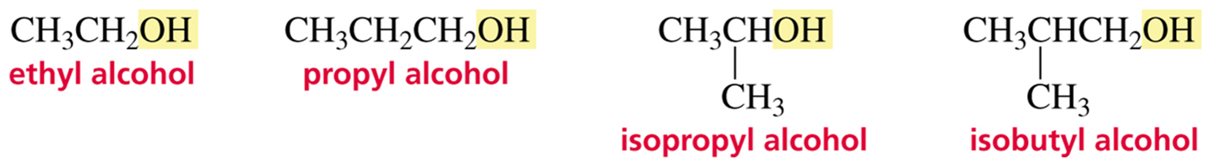
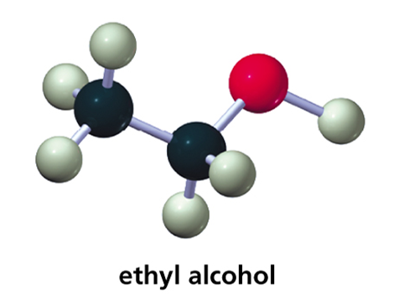
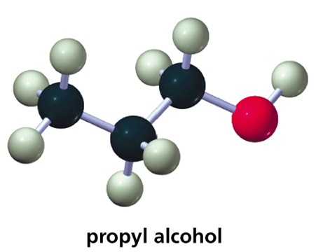
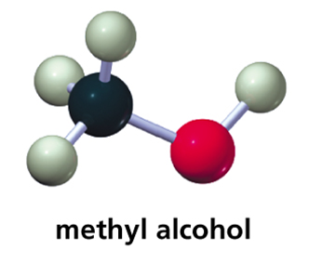
Common Names of Alcohol
Notes:
Ethyl alcohol is C H 3 C H 2 O H. Propyl alcohol is C H 3 C H 2 C H 2 O H. Isopropyl alcohol has a structure of C H 3 C H O H, where the second carbon (from left to right) has a single bond to C H 3. Isobutyl alcohol has a structure of C H 3 C H C H 2 O H, where the second carbon (from left to right) has a single bond to C H 3.

Slide 34
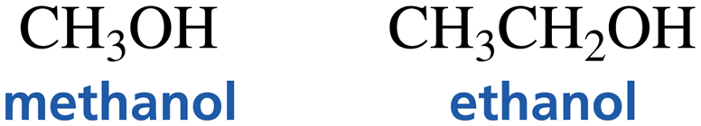
Systematic Names of Alcohols (1 of 2)
The OH is the “functional group.”
Systematic nomenclature uses a suffix to denote a functional group.
Alcohols are named by replacing the “e” at the end of the parent hydrocarbon with the suffix “ol.”

Slide 35
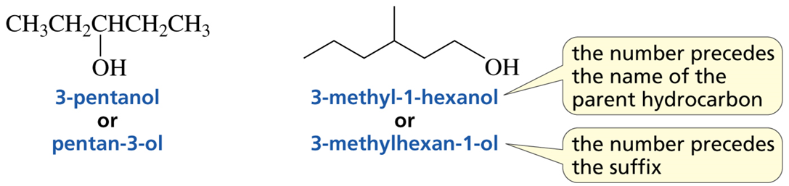
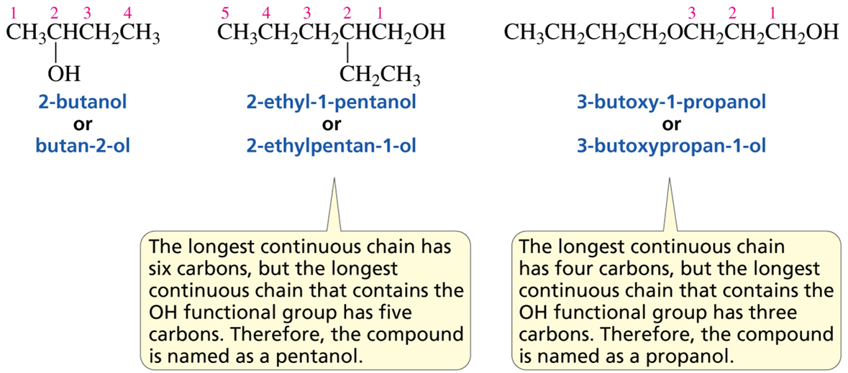
Systematic Names of Alcohols (2 of 2)

Slide 36
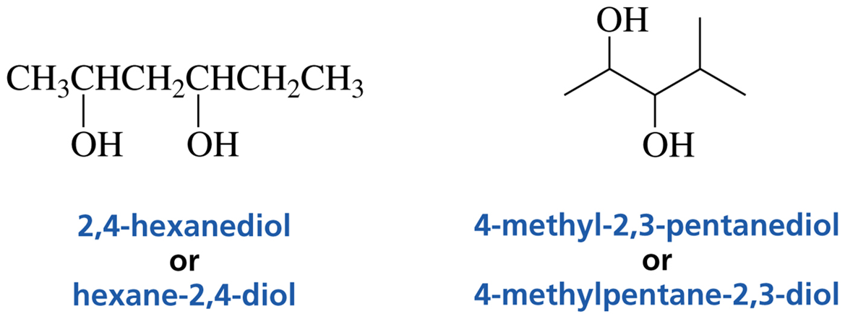
Compounds with Two OH Groups
Notes:
2,4-hexanediol, or hexane-2,4-diol, has a structure of C H 3 C H C H 2 C H C H 2 C H 3, where C 2 (from left to right) and C 4 both have a single bond to O H.
4-methyl-2,3-pentanediol, or 4-methylpentane-2,3-diol has a line-angle structure of a five-carbon chain where C 2 has a single bond to O H, C 3 has a single bond to O H, and C 4 has a single bond to C H 3.

Slide 37
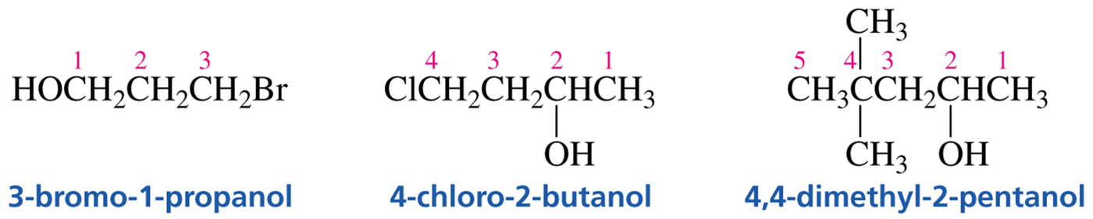
Nomenclature of Alcohols (1 of 4)
When there is both a functional group and a substituent, the functional group gets the lowest number.
Notes:
3-bromo-1-propanol has a structure of H O C H 2 C H 2 C H 2 B r. The carbons are numbered from 1 to 3 from left to right.
4-chloro-2-butanol has a structure of C l C H 2 C H 2 C H C H 3. The carbons are numbered from 1 to 3 from right to left. C 2 has a single bond to O H.
4,4-dimethyl-2-pentanol has a structure of C H 3 C C H 2 C H C H 3. The carbons are numbered from 1 to 5 from right to left. C 2 has a single bond to O H. C 4 has single bonds to two C H 3 groups.

Slide 38

Nomenclature of Alcohols (2 of 4)
The parent hydrocarbon is the longest chain that contains the functional group.
Number the chain in the direction that gives the functional group the lowest possible number.

Slide 39
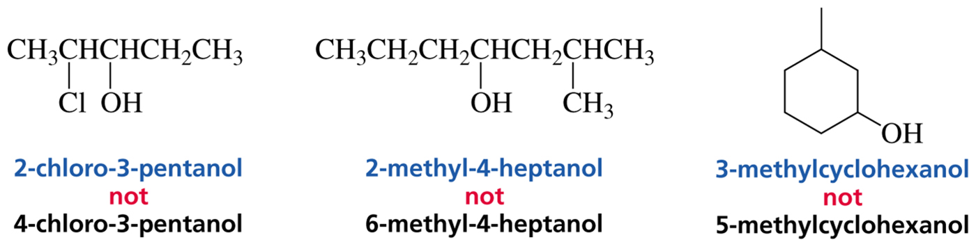
Nomenclature of Alcohols (3 of 4)
If you get the same number for the functional group in both directions, chose the direction that gives a substituent the lowest number.
Notes:
2-chloro-3-pentanol has a structure of C H 3 C H C H C H 2 C H 3, where C 2 (from left to right) has a single bond to C l and C 3 has a single bond to O H. 4-chloro-3-pentanol is a wrong name for this structure.
2-methyl-4-heptanol has a structure of C H 3 C H 2 C H 2 C H C H 2 C H C H 3, where C 4 (from right to left) has a single bond to O H and C 2 has a single bond to C H 3. 6-methyl-4-heptanol is a wrong name for this structure.
3-methylcyclohexanol has a structure of a six-carbon ring where C 1 has a single bond to O H and C 3 has a single bond to C H 3. 5-methylcyclohexanol is a wrong name for this structure.

Slide 40
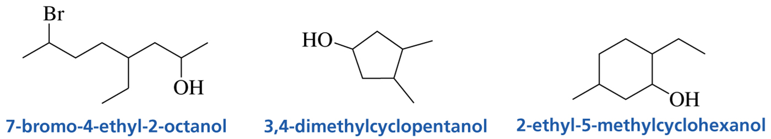
Nomenclature of Alcohols (4 of 4)
If there is more than one substituent, listed them in alphabetical order.
Notes:
7-bromo-4-ethyl-2-octanol has a line-angle structure of an eight-carbon chain where C 3 has a single bond to O H, C 4 has a single bond to a two-carbon substituent, and C 7 has a single bond to B r. 3,4-dimethylcyclopentanol has a structure of a five-carbon ring. C 1 has a single bond to O H. C 3 and C 4 both have a single bond to C H 3.
2-ethyl-5-methylcyclohexanol has a structure of a six-carbon ring. C 1 has a single bond to O H. C 2 has a single bond to C H 2 C H 3. C 5 has a single bond to C H 3.

Slide 41
A Substituent is a Prefix A Functional Group is a Suffix

Slide 42
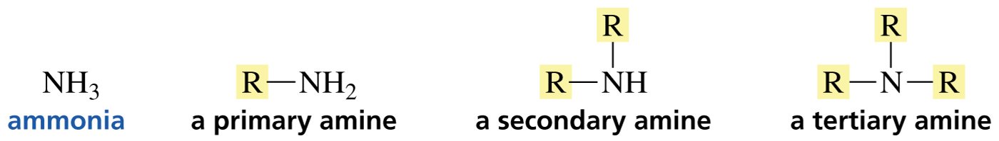
Classification of Amines
The classification depends on how many groups (R) are bonded to the N.
primary amine: one group bonded to the N
secondary amine: two groups bonded to the N
tertiary amine: three groups bonded to the N

Slide 43
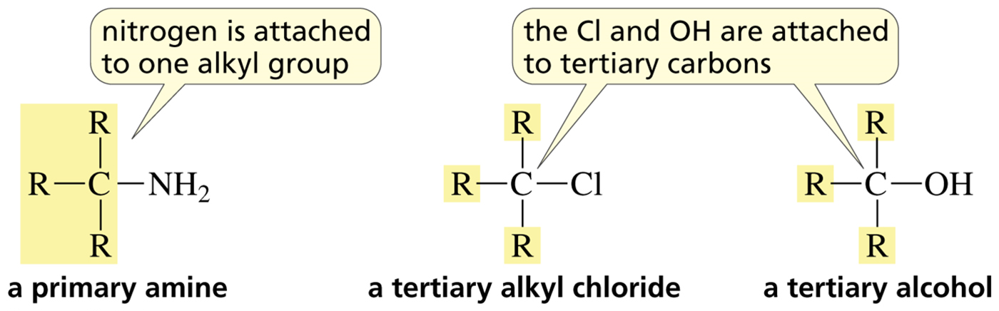
Classification of Amines versus Alkyl Halides and Alcohols

Slide 44
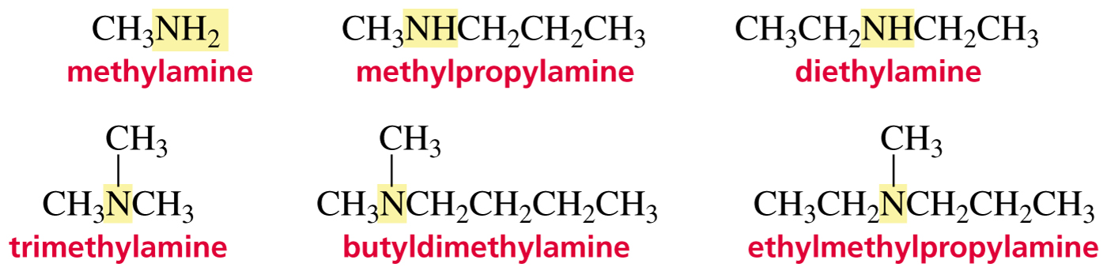
Common Names of Amines
Substituents are listed in alphabetical order followed by “amine.” They are written as one word.
Notes:
Methylamine is C H 3 N H 2. Methylpropylamine is C H 3 N H C H 2 C H 2 C H 3. Diethylamine is C H 3 C H 2 N H C H 2 C H 3. Trimethylamine has a structure of C H 3 N C H 3, where N has a single bond to one more C H 3 group. Butyldimethylamine has a structure of C H 3 N C H 2 C H 2 C H 2 C H 3, where N has a single bond to one more C H 3 group. Ethylmethylpropylamine has a structure C H 3 C H 2 N C H 2 C H 2 C H 3, where N has a single bond to C H 3.

Slide 45
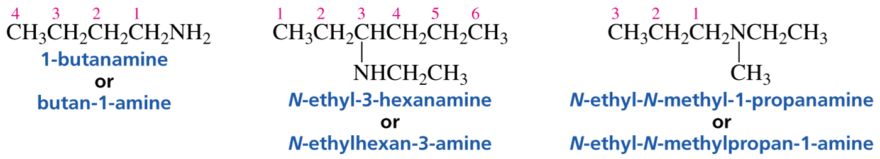
Systematic Names of Amines
The suffix “amine” denotes the amine functional group.
The “e” at the end of the alkane name is replaced by “amine.”

Slide 46
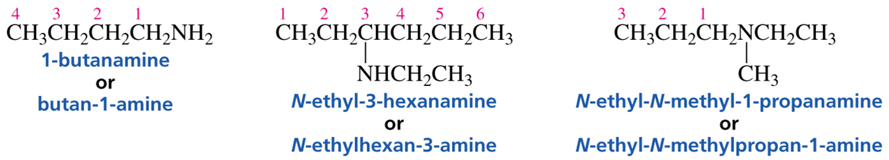
Nomenclature of Amines (1 of 2)
A substituent on the chain is indicated by a number.
A substituent on the nitrogen is indicated by an “N.”

Slide 47

Nomenclature of Amines (2 of 2)
List substituents in alphabetical order, then add a number or N.

Slide 48

Quaternary Ammonium Salts
When there are four groups bonded to the N, the groups are stated in alphabetical order followed by “ammonium” and then the name of the anion.
Notes:
Tetramethylammonium hydroxide is a salt. The cation contains a central positively charged N atom that has single bonds to four C H 3 groups. The anion is H O minus. Ethyldimethylpropylammonium chloride is a salt. The cation contains a central positively charged N atom. It has single bonds to two C H 3 groups, a single bond to C H 2 C H 3, and a single bond to C H 2 C H 2 C H 3. The anion is C l minus.

Slide 49








Summary of Nomenclature
Compound | Systematic name | Common name
Alkyl halide | substituted alkane C H 3 B r bromomethane C H 3 C H 2 C l chloroethane | alkyl group attached to halogen, plus halide C H 3 B r methyl bromide C H 3 C H 2 C l ethyl chloride
Ether | substituted alkane C H 3 O C H 3 methoxymethane C H 3 C H 2 O C H 3 methoxyethane | alkyl groups attached to oxygen, plus ether C H 3 O C H 3 dimethyl ether C H 3 C H 2 O C H 3 ethyl methyl ether
Alcohol | functional group suffix is ol C H 3 O H methanol C H 3 C H 2 O H ethanol | alkyl group attached to OH, plus alcohol C H 3 O H methyl alcohol C H 3 C H 2 O H ethyl alcohol
Amine | functional group suffix is amine C H 3 C H 2 N H 2 ethanamine C H 3 C H 2 C H 2 N H C H 3 N-methyl-1-propanamine | Alkyl groups attached to N, plus amine C H 3 C H 2 N H 2 ethylamine C H 3 C H 2 C H 2 N H C H 3 methylpropylamine

Slide 50

The Structure of an Alkyl Halide
The structure of an alkyl halide is the same as the structure of an alkane with a halogen replacing an H.
The C—X bond of an alkyl halide becomes longer and weaker as the size of the halogen increases.

Slide 51

The Structure of an Alcohol Resembles the Structure of Water
An alcohol is structurally like water with one H replaced by an R.

Slide 52

The Structure of an Ether Resembles the Structure of Water
An ether is structurally like water with both Hs replaced by Rs.

Slide 53

The Structures of Amines
The N in an amine has the same geometry as the N in ammonia.
Notes:
Methylamine, a primary amine, has a structure that shows a central N atom. It has a single bond to C H 3 on the left, a dashed wedge to H on the right, and a solid wedge to H at the bottom. N also has a teardrop-shaped lobe at the top that carries a lone pair. Dimethylamine, a secondary amine, has a structure that shows a central N atom. It has a single bond to C H 3 on the left, a dashed wedge to C H 3 on the right, and a solid wedge to H at the bottom. N also has a teardrop-shaped lobe at the top that carries a lone pair. Trimethylamine, a tertiary amine, has a structure that shows a central N atom. It has a single bond to C H 3 on the left, a dashed wedge to C H 3 on the right, and a solid wedge to C H 3 at the bottom. N also has a teardrop-shaped lobe at the top that carries a lone pair.
In each electrostatic map, there is a region with a negative electrostatic potential at the N atom and a region with a moderate potential at the remaining part of molecules.

Slide 54





Common Names
Notes:
Methyl alcohol is C H 3 O H. Ethylamine is C H 3 C H 2 N H 2. Propyl bromide is C H 3 C H 2 C H 2 B r. Butyl chloride is C H 3 C H 2 C H 2 C H 2 C l. Methyl iodide is C H 3 I. Ethyl alcohol is C H 3 C H 2 O H. Propylamine is C H 3 C H 2 C H 2 N H 2. Ethyl methyl ether is C H 3 C H 2 O C H 3.

Slide 55
Naming complex organic compounds
Identify the principal functional group present in the structure.
The principal functional group is the one that has the highest precedence
The principal functional group is incorporated as a suffix and all other groups are treated as prefix.
(modified from Skonieczny, S. Journal of Chemical Education. 2006, 83, 1633-1637)

Slide 56
Functional Groups and Intermolecular Forces
Intermolecular forces: weak attractive forces that molecules exert on each other when they are in close proximity
Types of intermolecular forces:
electrostatic
dipole–dipole interactions
hydrogen bonding
London forces (dispersion forces)

Slide 57

Electrostatic Interactions
Electrostatic interactions take place where the organic functional groups have a full formal charge, creating a strong attractive forces between the molecules.

Slide 58




Dipole–Dipole Interactions
Attractive force between the negative end of a permanent dipole in a molecule and the positive end of a permanent dipole in a neighbouring molecule (or vice versa)
A polar molecule has a net overall dipole.
Dipole–dipole interactions are stronger than London dispersion forces.

Slide 59


Hydrogen Bonding
Hydrogen bonding is a strong dipole-dipole interaction.
Attractive force between a lone pair of N or O atom in a molecule and a H atom that is covalently bonded to a N or O atom in a neighboring group
Polar protic solvents act as hydrogen bond donors.
Hydrogen Bonds in Water

Slide 60

Hydrogen Bonds in Amines
Hydrogen bonds are stronger in primary amines than in secondary amines because primary amines have stronger dipole-dipole interactions.
Tertiary amines cannot form hydrogen bonds with each other.

Slide 61

London Forces (Dispersion forces)
London forces or dispersion forces are weak intermolecular interactions.
Attractive interactions that exist between all molecules in close proximity to each other.
Result from small temporary dipoles induced in each molecule by the other.
Particularly important for non-polar molecules (no net dipole)
δ+ δ-
δ+ δ-
δ+ δ-
non polar molecule
symmetrical charge distribution
Electrons move & are concentrated in one region.
“instantaneous dipole”
Temporary dipole can cause neighboring molecule to have similar dipole.

Slide 62

Intermolecular Forces and Physical Properties: Boiling point and Melting point
Long linear hydrocarbon chains have greater surface area- increased dispersion.
Branched hydrocarbons have less surface area compared to the linear hydrocarbons and therefore less dispersion forces.
Ring structures have more rigid structures which improves molecular packing which increases intermolecular interactions resulting in higher melting and boiling points.

Slide 63

The greater the surface area of the molecule, the higher the boiling point.
Long, straight chains
Higher boiling point
More surface area for contact
Stronger van der Waals forces
Hydrocarbon
methane
ethane
propane
butane
pentane | 36.1
hexane | 68.7
heptane | 98.4
octane | 125.7
Branched chains
Spherical-smaller surface area of contact
Lower boiling point-weaker van der Waals forces
Octane 2,2,4-Trimethylpentane
boiling point 125.7 ºC boiling point 99.2 ºC

Slide 64

Branching Lowers the Boiling Point

Slide 65

Intermolecular Forces and Physical Properties: Boiling point and melting point
Dipole-dipole interactions are stronger than dispersion forces.
Molecules that have permanent dipoles have stronger intermolecular interaction.
Molecules with higher polar functional groups have stronger intermolecular interactions.
Hydrogen bonds provide strong intermolecular interactions.

Slide 66

Intermolecular Forces and Physical Properties: Boiling point and melting point
Electrostatic interactions are the strongest intermolecular force.
Organic molecules with permanent charges form a strong interaction with their counter ions – leading to higher bp and mp
Number of functional groups in a molecule – influences the physical properties

Slide 67


Melting Points
The melting point is influenced by the packing of the molecules in the crystal lattice.
Alkanes with an odd number of carbons pack less tightly.
Notes:
A line graph has the melting point (degrees Celsius) on the Y-axis, ranging from negative 200 to 50 with the intervals of 50, and the number of carbon atoms on the Y-axis, ranging from 0 to 20 with the intervals of 1. There are two lines graphed: one for odd numbers and the other one for even numbers. For the odd numbers, the line passes through the following points: negative 200 degrees for 3 carbons, negative 150 degrees for 5 carbons, negative 100 degrees for 7 carbons, negative 50 degrees for 9 carbons, negative 40 degrees for 11 carbons, then going as a straight line until 25 degrees for 19 carbons. The line representing even numbers is located slightly higher.

Slide 68

Physical properties of alkanes

Slide 69



Solubility: Like Dissolves Like
Classes of organic solvents:
Polar protic solvents: can act as hydrogen bond donors and are often miscible with water
Polar aprotic solvents: strong dipoles; most can act as hydrogen bond acceptors; tend to be miscible with water
Non-polar solvents: Molecules are
primarily held together by London forces.
15

Slide 70

Hydrophilicity and Hydrophobicity
Hydrophobic (“water fearing”) compounds
Hydrophilic (“water loving”) compounds:

Slide 71


Relative Solubility in Water
Water Solubility
At least 3gr in 100 mL water
1-3C: water soluble
4-5C: borderline
≥ 6 C: insoluble
Solvation is the interaction between solute molecules and solvent molecules.
e.g. MeOH and H₂O are miscible in all proportions

Slide 72


Solubility of Branched vs Unbranched Molecules
Solubility of Charged Molecules in Water

Slide 73

Condensed Structures
Lewis structures can be simplified by showing only the atoms in a molecule as a “list” and eliminating the lines showing covalent bonds
These are called “condensed” structures:
=
pentane
C-C and C-H bonds are not shown
C with 3 hydrogens = CH₃
C with 2 hydrogens = CH₂
HONC Rule:

Slide 74
Skeletal or Line Structures
=
Each vertex and end of each line is a carbon.
Each unspecified valence is a hydrogen.
Rule 1
Rule 2
Rule 3
Rule 1: Carbon atoms are not shown Each line segment represents a C at each end.
Rule 2: H’s are omitted, except when connected to an explicitly drawn atom (i.e. O, N, S, etc). H’s connected to C atoms are implied.
Rule 3: Atoms other than C or H (example: O, N, S, etc) are shown

Slide 75
Constitutional or Structural isomers: compounds with the same molecular formula but a different connectivity (different order of attachment of their atoms)
For n > 3, alkanes can have constitutional isomers (different bonds). As C # increases, number of isomers increases dramatically-NO FORMULA; write out systematically.
pentane
isopentane
neopentane

Slide 76
3-D representations of molecules:
1) Perspective or Dimensional or Wedge & Dash formulas
Do not try to draw the stereochemistry of the end methyl groups or other substituents if they are not important.
Notes:
Drawings of molecules are 2-D attempts to show 3D structures and so chemists commonly use perspective formulas to show the 3-D spatial arrangements resulting from rotation around the sigma bond, also newman projections are used.

Slide 77


Rotation around C-C bonds
σ bonds formed by overlap of one sp³ orbital with another sp³ orbital
bonds symmetrical along line connecting center of two atoms
Rotation around σ bonds occurs without change in amount of orbital overlap
Rotation about C-C single bonds usually occurs freely.
Different spatial arrangements of atoms as a result of rotation around C-C bond:
Notes:
Orbital depiction and structure of a carbon-carbon single bond, showing allowed rotational motion.

Slide 78
Conformations of open-chained compounds
are the temporary molecular shapes that result from rotation about single bonds.
are each possible structure.
is the study of the energy changes associated with a molecule undergoing rotation about single bonds.
Three 3D ways to represent ethane on a 2D paper

Slide 79
Drawing Conformers-Ethane
2) Sawhorse Representations:
view C-C bond obliquely
3) Newman Projections: view C-C bond end on
H on “front” C – lines go to centre of circle
H on “back” C – lines go to edge of circle
Energy difference is due to strain.
Notes:
Newman projection: assume looking along longitudinal axis of a C-C bond in molecule, carbon in front is represented as a point where 3 lines meet, and carbon in the back is a circle; three lines coming out of it represent its other 3 bonds. Staggered conformation is more stable and lower in energy than eclipsed; so because of this energy difference rotation around the single bond is not entirely “free”. So to rotate from staggered to eclipse, you have to overcome the 12 kj/mol energy barrier, but this is so small that in ehtane there is continuous rotation and at room temp this happens millions of times per second; so since this is so fast, the conformers cannot be seprated from each other; conformational analysis is the investigation of various conformations and their relative stabilities.

Slide 80
: the angle that separates a bond on one atom from a bond on an adjacent atom.
The conformation shown below is called the staggered conformation and the dihedral angle is 60º.
Changing the staggered conformation to eclipsed conformation

Slide 81
Torsional strain: the force that opposes the rotation of one part of a molecule about a bond while the other part of the molecule is held fixed-due to eclipsing of C-H bonds and repulsion of their electron clouds
the torsional strain between eclipsed and staggered ethane is
approximately 12 kJ/mol
+12 kJ/mol
+12 kJ/mol
Each H-H bond, 1kcal/mol electron repulsion; total = 3 kcal/mol (12 kJ/mol)
This energy easily obtained at room temperature.

Slide 82

Rotational Energy Diagram
Dihedral Angle
Go through conformers of propane yourself!
Notes:
Potential energy of ethane as a function of the angle of rotation about the carbon-carbon bond.
The staggered conformations are at energy minima-these called “conformers”, whereas eclipsed conformations are at energy maxima. So ethane has 3 “conformers”
Diagram shows potential energies of all conformations of ethane obtained in one complete 360 degree rotation about the C-C bond.

Slide 83

Conformations of butane
rotate
rotate
rotate
60°
60°
60°
A
rotate
rotate
rotate
60°
60°
60°
Notes:
First newman projection get 180 degree angle between two Me groups (farthest apart they can be) so the most stable conformer and lowest in energy for butane-this is called the “anti conformation”, then rotate the back carbon by 60 degrees keeping the front carbon stationary and get the conformer B with the angle between H and Me at 0 degrees ( 2 sets) so get some torsional strain, so this conformer (B) would be higher in energy than A. continue to rotate 60 degrees each time to get the next conformers until full 360 degree rotation get back to conformer A. conformer C which also is staggered is called the “gauche conformation” in which the two large substit are adjacent, compared to the anti in which the two large substit are opposite each other. Eclipsed conformations have different energies too; when the two methyl grps are closest, like in D, this is higher in energy than when they are farther apart, like in B.

Slide 84

Conformations of Butane
19 kJ/mol
16 kJ/mol
3.8 kJ/mol
Dihedral angle
Notes:
The energy diagram for rotation around the C2-C3 bond of butane is shown here. The letters identify the conformers you saw in the previous slides, the degree of rotation is shown by the dihedral angle shown on the x-axis at the bottom. This is the angle in the newman projection between the C-C bond on the front carbon and the C-C bond of the back carbon.

Slide 85

Steric strain: the strain (extra energy) that arises in a molecule when atoms or groups are forced close to one another, causing repulsion between electron clouds
Consider butane:
conformation: substituents 180º
from one another.
no torsional strain
no steric strain
conformation: substituents 60º from one another.
steric strain is approximately 3.8 kJ/mol- “gauche interaction”
Notes:
Anti and gauche conformations, though both staggered, don’t have the same energy due to steric strain. There is more steric strain in the gauche than in anti since the two substit, in the case of butane, the two Me groups, are much closer to each other so you can see their electron clouds and the H atoms on the C bump into each other. Steric strain increases as the size of the interacting atoms or groups increases

Slide 86
Types of strain in organic molecules
Interaction
H H eclipsed
H CH₃ eclipsed
CH₃ CH₃ eclipsed
CH₃ CH₃ gauche
Cause
torsional strain
mostly torsional
torsional + steric
steric strain
Energy cost (kJ/mol)
4.0
6.0
11
3.8
Notes:
Summary list of types of interactions and their energy, based on dihedral angle of newman projection. Since C-C single bonds are constantly rotating, molecules are not static and there are thousands of conformations of a molecule at any given moment, the relative number of molecules with a particular conformation at any given time depends on the stability of the conformation; the more stable the conformation and the lower its energy, the more molecules will have that particular conformation in the sample of a compound. So most molecules will be in the staggered conformation and more will be in the anti conformation than in a gauche form.

Slide 87

Stability of Cycloalkanes: The Baeyer Strain Theory
Baeyer (1885): assumed cycloalkanes planar polygons; since sp³-hybridized carbon prefers to have bond angles of approximately 109.5°; stability of cycloalkane predicted by difference between ideal angle and bond angle in planar cycloalkane
Rings from 3 to 30 C’s do exist but are strained due to bond bending distortions and steric interactions-larger rings have many more conformations than smaller rings
Notes:
Early chemists found that cyclic cmpds in nature are usually 5 or 6 member rings and 3 and 4 carbon ring cmpds are quite rare. This means that 5 and 6 member rings are more stable. Bayer suggested 4 and 3 member rings are unstable due to angle strain. So stability of cycloalkane can be predicted by assessing difference b/w real bond angle in flat cycloalkane and the ideal 109.5 degree angle-the deviation between the two numbers he called the ANGLE STRAIN, and thus instability of the cycloalkane so the larger the deviation, the more strain in the molecule, so the less stable the cycloalkane. So cyclopropane with the highest deviation would be highest in energy and the least stable.

Slide 88


Cycloalkane strain energies
Notes:
Bayer predicted that most stable cycloalkane would be the 5-member ring since it would have the smallest deviation from the ideal 109.5 (only one degree difference) but experimentally and in reality as you can see from the graph above the most stable cycloalkane is the 6 member ring with no ring (or angle) strain at all. Bayer’s mistake was that he thought all cycloalkanes are planar so he thought the 6 member ring would have angles of 120 degrees (about 11 degree deviation from 109). After 6 members, he thought the bigger the ring, the less stable it would be but you can see from the graph above that is not the case. Only cyclopropane is truly planar since 3 points define a plane so all 3 atoms must be in the same plane but beyond 3 carbons the other cycloalkanes are not planar an they twist and bend in order to minimize the ring and angle strain and to maximize the stability and also to minimize the number of eclipsing hydrogen atoms, which would create torsional strain.

Slide 89
Cycloalkanes
Ring Size | Heat of combustion (kJ mol⁻¹) | Heat of Combustion per CH₂ Group (kJ mol⁻¹) | Strain (kJ mol⁻¹)
3 | 2091 | 697.0 | 115
4 | 2744 | 686.0 | 109
5 | 3320 | 664.0 | 27
6 | 3952 | 658.7 | 0
7 | 4637 | 66328 | 27
8 | 5310 | 663.6 | 42
9 | 5981 | 664.6 | 54
10 | 6636 | 663.6 | 50
Unbranched |  | 658.6
Heats of combustion per CH₂ unit reveal cyclohexane produces the lowest heat of combustion compared to other cycloalkanes.
Why? Angle strain and Torsional strain

Slide 90
Cycloalkanes
Cycloalkanes distort from planar geometry (by ring puckering)
to minimize:
torsional strain (caused by eclipsing bonds)
angle strain (sp³ C wants 109.5 º angles)
steric strains (repulsion between groups that are close together)
No free rotation about C-C bonds in smaller rings (n<8).
Rings larger than 3 atoms are not flat

Slide 91

Angle strain: the strain caused by compression
or expansion of bond angles.
Cyclopropane
Strain energy is approx. 115 kJ/mol due to angle strain and torsional strain: the C-C-C bond angles are compressed from 109.5° to 60°
there are also 6 sets of eclipsed
hydrogen interactions
Cyclopropane – 3-member ring has planar structure
3
2
angle torsional
strain strain
3
2
60º
1
1
Cyclopropane is very reactive!

Slide 92


Bent (Banana) Bonds of Cyclopropane
Notes:
Angle strain in 3 member cyclopropane can be seen if you look at the overlap of orbitals that form the sigma bonds in the molecule. Normal sigma bonds you have seen are formed by head to head overlap of two sp3 orbitals. In cyclopropane, because of the angle between the bonds (60 degrees) the two orbitals cannot directly point towards each other, so the amount of overlap between them is less than in a normal C-C bond. This smaller amount of overlap leads to weaker than normal C-C bonds which is why cyclopropane reacts easily and the bonds can break easily. Because the orbitals do not point directly at each other, the bonds they form have shapes that look like bananas so they call them ‘banana’ bonds. In additon to angle strain, the hydrogens are all eclipsed with each other so they create even more strain.

Slide 93


Cyclobutane
Strain energy is about 110 kJ/mol
Slightly bent out of plane-one carbon 25° above plane of other three carbons
puckering from planar cyclobutane reduces
torsional strain but increases angle strain
the conformation of minimum potential
energy is the “butterfly” conformation
2
4
1
3
Notes:
Cyclobutane has less angle strain than cyclopropane, but it has more eclipsed hydrogen atoms (4 pairs vs 3 pairs). Because of this, it is not planar, but bent with one CH2 group above the plane defined by the other 3 carbons.

Slide 94

Cyclopentane
The strain energy of cyclopentane is about 26 kJ/mol
Planar cyclopentane-no angle strain but high torsional strain
puckering from planar cyclopentane reduces
torsional strain but increases angle stain
− fifth carbon above or below plane-like an envelope
Minimum energy conformer
is the “envelope” conformation
Notes:
If cyclopentane planar, it would have NO angle strain, but would have 10 H atoms eclipsing, so high torsional strain. So cyclopentane puckers like an envelope, allowing the H atoms to become nearly staggered, but in the process the molecule acquires some angle strain. This puckered form is called the envelope conformation.

Slide 95

Cyclohexane
To be free of angle strain, tetrahedral bonds needed (non-planar): 2 conformations available:
Chair conformation: the most stable puckered conformation of a cyclohexane ring-completely “strain-free”
all bond angles are approx. 109.5° (111°)
all bonds on adjacent carbons
are staggered (no torsional strain)
flat
120º angles
chair conformation
Cyclohexane has no angle strain or torsional strain.

Slide 96


Newman projection of Chair Conformer

Slide 97


Cyclohexane
Two positions for Hydrogens
- (angled up/down)
- (straight up/down)
Chair cyclohexane has six hydrogens parallel to the ring axis
& six hydrogens around the ring equator
-Axial bonds alternate up and down around ring
-Equatorial bonds alternate up and down around ring
-Each ring carbon has one up and one down bond attached to it
-Each ring carbon has one axial and one equatorial bond attached to it

Slide 98
In a chair conformation, six H are equatorial and six are axial:
axial
equatorial
Drawing a molecule of cyclohexane:

Slide 99
How NOT TO DRAW the cyclohexane chair:

Slide 100
Cyclohexane: Chair conformations readily interconvert,
resulting in the positions by a
ring-flip
2 chair conformations:
A ring flip converts all equatorial H’s to axial H’s and all axial to equatorial.
For C₆H₁₂, both conformers are equally stable and the ring flipping occurs rapidly at room temperature.

Slide 101

Monosubstituted Cyclohexanes
The two conformers of a monosubstituted cyclohexane are not
equal in energy
methylcyclohexane
More stable
by ~ 8 kJ/mol
One substituent is always more stable in the position.

Slide 102

Methylcyclohexane
∆Gº = +7.6 kJ/mol
Strain of one H-Y 1,3-diaxial interaction = steric strain
H
Y
- depends on Y
- for Y = CH₃, ∆Gº = +3.8 kJ/mol
3
1
2
Hydrogen atoms of the axial methyl group on C1 are too close to
the axial hydrogens three carbons away on C3 and C5
resulting in 7.6 kJ/mol of steric strain

Slide 103

Methylcyclohexane
Axial methyl group also has gauche interaction with adjacent C-C bond

Slide 104

Steric Strain in Monosubstituted Cyclohexanes
Y
kJ/mol
Strain of one H-Y 1,3-diaxial interaction
-F
0.5
Y
H
-Cl
1.0
1
-Br
1.0
3
2
-OH
2.1
-CH₃
3.8
-CH₂CH₃
4.0
-CH(CH₃)₂
4.6
-C(CH₃)₃
11.4
-C₆H₅
6.3
-COOH
2.9
-CN
0.4

Slide 105


The Only Difference Between Starch and Cotton is an Equatorial Bond versus an Axial Bond

Slide 106

Disubstituted Cyclohexanes: Cis and Trans Isomers

Slide 107


Each Isomer Has Two Chair Conformers

Slide 108
Disubstituted Cyclohexanes
2 isomers of
1,2-dimethylcyclohexane
1,2-dimethylcyclohexane
cis
Cannot interconvert between cis and trans without breaking bonds.
Which of the two conformers is most stable for each isomer?

Slide 109
Disubstituted Cyclohexanes
1,2-dimethylcyclohexane
2 isomers of
1,2-dimethylcyclohexane
trans

Slide 110
Disubstituted Cyclohexanes
1,4-dimethylcyclohexane: planar hexagon representations
cis
trans
cis-1,4-dimethylcyclohexane

Slide 111
Disubstituted Cyclohexanes
trans-1,4-dimethylcyclohexane
∆Gº = 4 (+3.8 kJ/mol)
= +15.2 kJ/mol

Slide 112
Trans-1,3-Disubstituted Cyclohexanes
Cis-1,3-Disubstituted Cyclohexanes

Slide 113


Very bulky groups such as “tert-butyl” ALWAYS in the equatorial position
because large steric strain by axial t-butyl “locks” ring in a single conformation

Slide 114

Draw two chair conformations and indicate which conformation is more stable?

Slide 115


Boat Cyclohexane – more conformations of cyclohexane
Boat conformation: a puckered conformation of a cyclohexane ring in which carbons 1 and 4 are bent toward each other
“flagpole hydrogens”
1
1
4
2
3
2
4
6
6
5
less stable than the chair conformation by +29 kJ/mol
No angle strain
Torsional strain due to eclipsing hydrogens
Steric strain due to proximity of flagple hydrogens
ΔGº = +29 kJ/mol
chair
boat

Slide 116



Ring Flipping Energy Diagram

Slide 117

Rings Can Be Trans Fused or Cis Fused

Slide 118



The Steroid Ring System

Slide 119

Conformations and Drug Action
Etorphine, a rigid morphine analog:

Slide 120


Conformations and Drug Action
Conformations of the neurotransmitter dopamine
Apomorphine natural products: conformationally-restricted forms of dopamine:
Apomorphine, active dopamine mimic; Isoapomorphine, inactive as dopamine mimic

Slide 121
Key Concepts
Alkanes = hydrocarbons with single bonds (C_{n}H_{2n+2}). Named by longest continuous carbon chain as parent, numbered with smallest numbers possible given to substituents, listed in alphabetial order.
Functional group: center of reactivity in molecule; organic molecules classified based on these groups
Alkyl halides: alkanes which have halogen as substituent.
Ethers: alkanes which have alkoxy groups as substituent.
Amines and alcohols: contain OH and NR₂ (R = H or alkyl,aryl) functional groups; named by using functional groups suffixes.
IUPAC naming rules
Intra- and Inter-molecular forces
Solubility rules
Chain Molecule Conformations
Cyclic Alkane Conformations
Cyclohexane chair conformations

